Slide 1
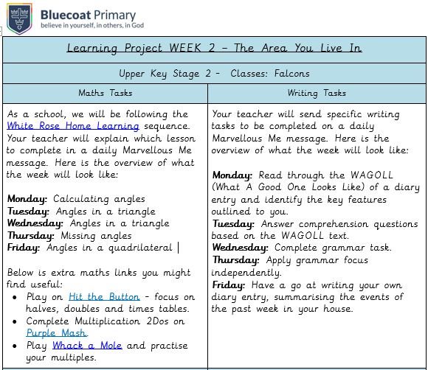

Slide 2
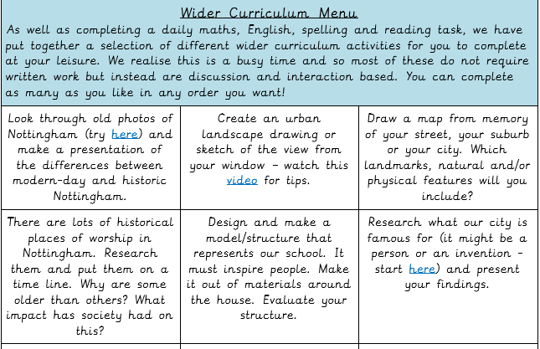
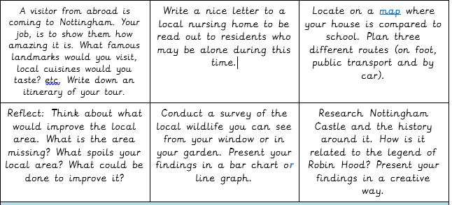

Slide 3
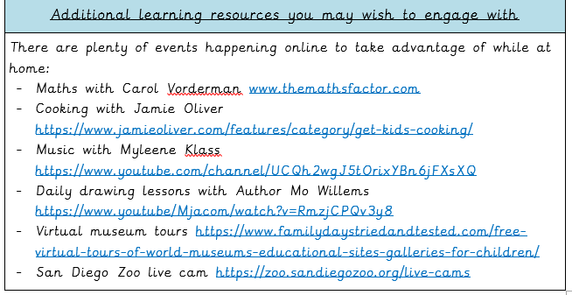

Slide 4
LO: To identify the features of a diary entry
Dear Diary
You will never guess what has happened to me! I have been plunged into a world I never quite believed in and if I am completely honest, I never saw this coming. I feel very overwhelmed.
As you know, I have moved into a huge, dusty, vintage house as filthy as a shack. In fact, it is more like a dozen shacks that have been stacked on top of one another!
Every now and then, I had been hearing sounds in the old walls that sounded like scratches or small footprints. It made me feel nervous because I was unsure what it was and part of me just wished that it would go away.
Yesterday, Mallory picked up an old broom in the kitchen and held it like it was a baseball bat. She quickly swung the bat at the pale, dull, worn wall and plaster came scattering to the floor beneath our feet like flour and a huge hole appeared (I knew Mom would blame me for it– she always does!).
Hesitantly, I stepped towards the ominous hole and I felt the hairs on my arms stand up. To my amazement, inside were the most bizarre objects! A doll’s head lolled in one corner. Dead cockroaches were strung up like garlands. Tiny soldiers with melted hands and feet were scattered all over like autumn leaves resting on the ground.
All of a sudden, the mysterious noise came back again! I had to quietly squeeze myself into the dumbwaiter (that’s where all the objects came from in the wall by the way) and it was really dirty inside and it smelled like old wood.
After a while, I arrived in a secretive room that had a low ceiling and crowded bookshelves surrounded me. Slowly, I looked around the room and I realised there was no door! What a strange place it was!
Monday 27th April

Slide 5
Bravely, I began to explore the creepy room. I found an array of objects like old books, a pair of round glasses, a large watercolour painting of a little girl and a man pleasantly playing on the lawn and a note. Just as I was feeling confident, the peculiar noises returned along with my Mom! So, I had to go back downstairs, I felt so disappointed because I really wanted to stay longer to find more clues.
This morning, the craziest thing happened! My alarm clock didn’t wake me up…Mallory’s loud screaming did! Something had tied her long, silky, brown hair to the bed and of course I got the blame! It wasn’t me and it wasn’t Simon. I felt very confused!
Certainly curious, I knew what I needed to do. I used the clues from the strange note I found yesterday and bravely made my way up to the undisturbed attic. Eventually, when I got there the room I entered was bright and small with dusty windows on all sides. There wasn’t much in the room, only an old trunk, a Victrola, a small stool and rolls of faded fabric.
Nervously, I opened the large, dry, neglected trunk. Nothing inside looked like it was a secret or something to be hidden, there was simply moth-eaten clothes inside. I felt disappointed because I was eagerly hoping to find something fascinating!
Using the clues in the note I found, I knew there was something in the trunk but it took me a while to work out where. Eventually, a secret compartment popped open! Excited beyond reason, I quickly reached inside and found an old crumbling book that smelt like burnt paper.

Slide 6
In the diary entry can you find:
Nouns, adjectives and verbs
Fronted adverbials
Adverbs
Nouns | Verbs | Adjectives | Adverbials | Adverbs

Slide 7
LO To calculate different angles
Monday 27th April Maths
Please use the linked video : https://whiterosemaths.com/homelearning/year-6/ Summer Week 1 Lesson 1
We have moved to week 3 instead of 2 as many of you will not have protractors so week 2 becomes very difficult.
Please complete the worksheet before the deep/deeper.
Any questions please e-mail me at bstanley@bluecoat.uk.com

Slide 8
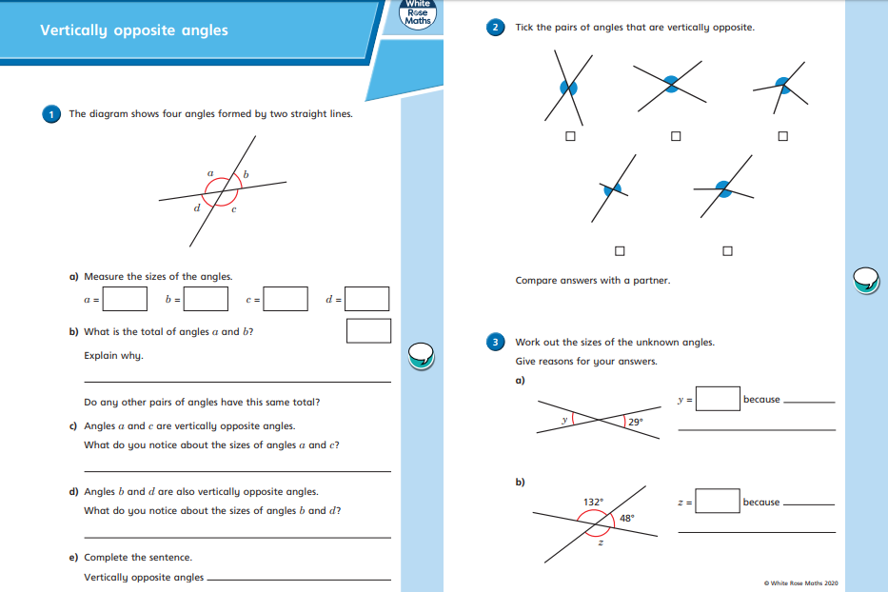

Slide 9
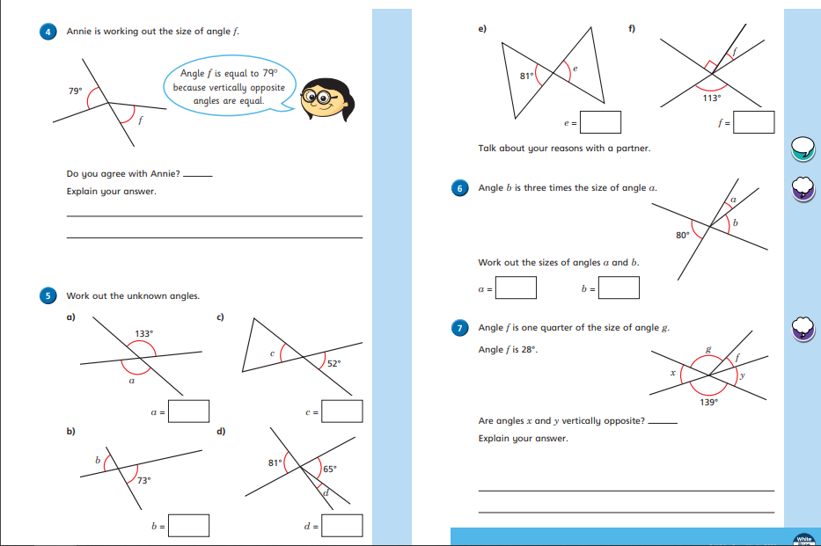

Slide 10
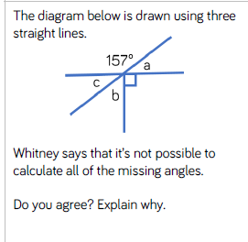
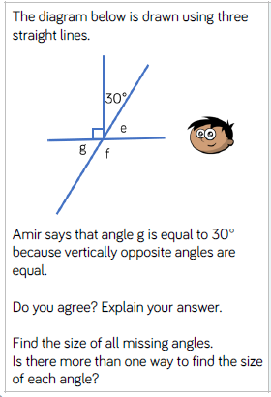

Slide 11
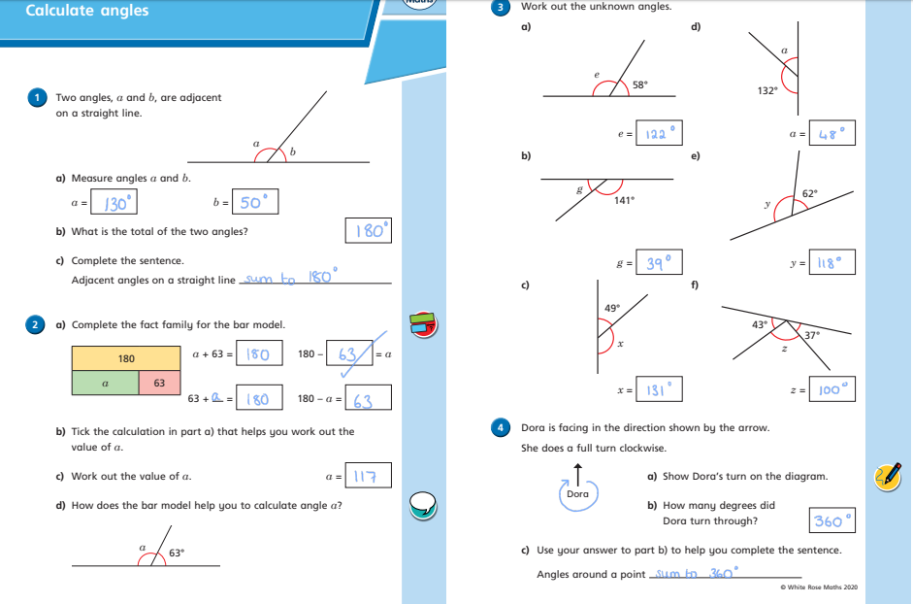

Slide 12
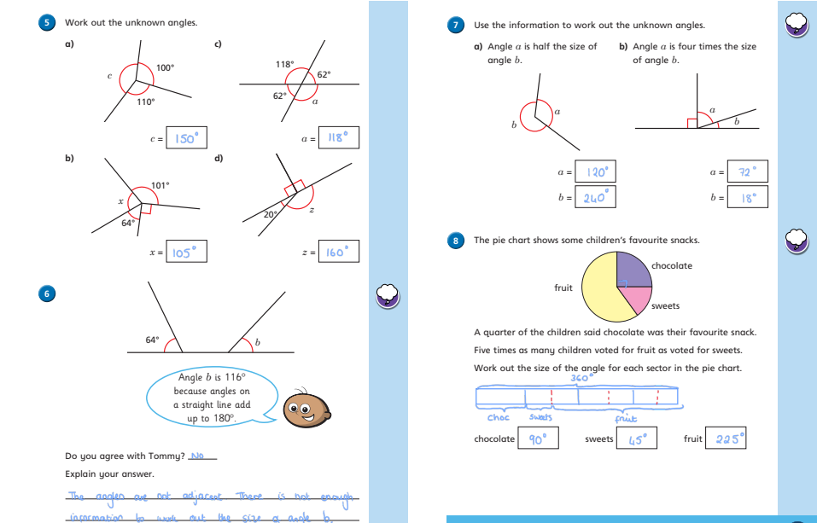

Slide 13
LO: To retrieve and infer information
Dear Diary
You will never guess what has happened to me! I have been plunged into a world I never quite believed in and if I am completely honest, I never saw this coming. I feel very overwhelmed.
As you know, I have moved into a huge, dusty, vintage house as filthy as a shack. In fact, it is more like a dozen shacks that have been stacked on top of one another!
Every now and then, I had been hearing sounds in the old walls that sounded like scratches or small footprints. It made me feel nervous because I was unsure what it was and part of me just wished that it would go away.
Yesterday, Mallory picked up an old broom in the kitchen and held it like it was a baseball bat. She quickly swung the bat at the pale, dull, worn wall and plaster came scattering to the floor beneath our feet like flour and a huge hole appeared (I knew Mom would blame me for it– she always does!).
Hesitantly, I stepped towards the ominous hole and I felt the hairs on my arms stand up. To my amazement, inside were the most bizarre objects! A doll’s head lolled in one corner. Dead cockroaches were strung up like garlands. Tiny soldiers with melted hands and feet were scattered all over like autumn leaves resting on the ground.
All of a sudden, the mysterious noise came back again! I had to quietly squeeze myself into the dumbwaiter (that’s where all the objects came from in the wall by the way) and it was really dirty inside and it smelled like old wood.
After a while, I arrived in a secretive room that had a low ceiling and crowded bookshelves surrounded me. Slowly, I looked around the room and I realised there was no door! What a strange place it was!
Tuesday 28th April

Slide 14
Bravely, I began to explore the creepy room. I found an array of objects like old books, a pair of round glasses, a large watercolour painting of a little girl and a man pleasantly playing on the lawn and a note. Just as I was feeling confident, the peculiar noises returned along with my Mom! So, I had to go back downstairs, I felt so disappointed because I really wanted to stay longer to find more clues.
This morning, the craziest thing happened! My alarm clock didn’t wake me up…Mallory’s loud screaming did! Something had tied her long, silky, brown hair to the bed and of course I got the blame! It wasn’t me and it wasn’t Simon. I felt very confused!
Certainly curious, I knew what I needed to do. I used the clues from the strange note I found yesterday and bravely made my way up to the undisturbed attic. Eventually, when I got there the room I entered was bright and small with dusty windows on all sides. There wasn’t much in the room, only an old trunk, a Victrola, a small stool and rolls of faded fabric.
Nervously, I opened the large, dry, neglected trunk. Nothing inside looked like it was a secret or something to be hidden, there was simply moth-eaten clothes inside. I felt disappointed because I was eagerly hoping to find something fascinating!
Using the clues in the note I found, I knew there was something in the trunk but it took me a while to work out where. Eventually, a secret compartment popped open! Excited beyond reason, I quickly reached inside and found an old crumbling book that smelt like burnt paper.

Slide 15
Page 1
How did Mallory hold the broom?
What was the house as filthy as?
What happened when Mallory swung the bat?
What was in the hole?
How would you have felt when you looked in the hole? Why?
Find two similes used on page one.
Page 2:
List 3 things found in the room. (2 marks)
Why did the character have to leave the room?
How did the character feel when leaving the room? Explain. (2marks)
Why was she disappointed when she first opened the trunk?
How would you feel after the secret compartment opened? Why? (2 marks)

Slide 16
LO To calculate angles
in a triangle
Tuesday 28th April Maths
Please use the linked video : https://whiterosemaths.com/homelearning/year-6/ Summer Week 1 Lesson 2
We have moved to week 3 instead of 2 as many of you will not have protractors so week 2 becomes very difficult.
Please complete the worksheet before the deep/deeper.
Any questions please e-mail me at bstanley@bluecoat.uk.com

Slide 18
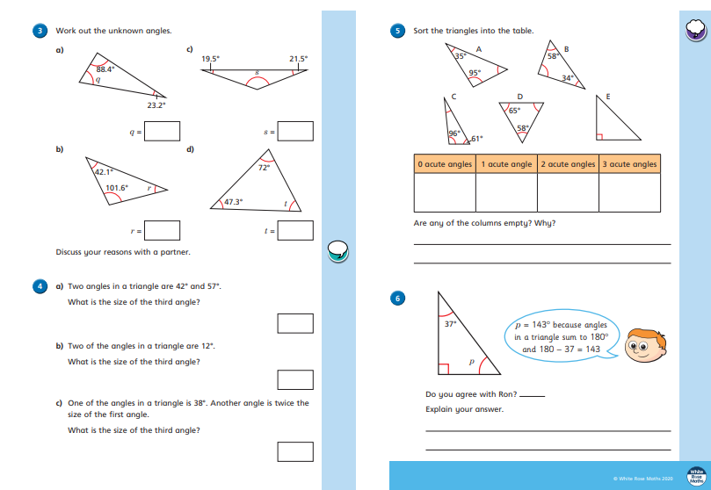

Slide 19
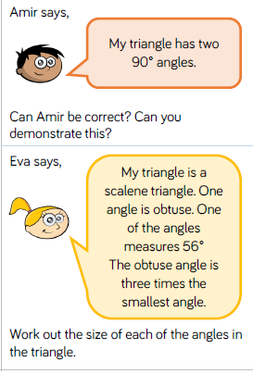
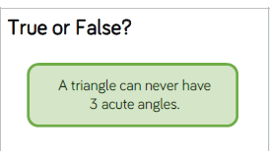

Slide 21
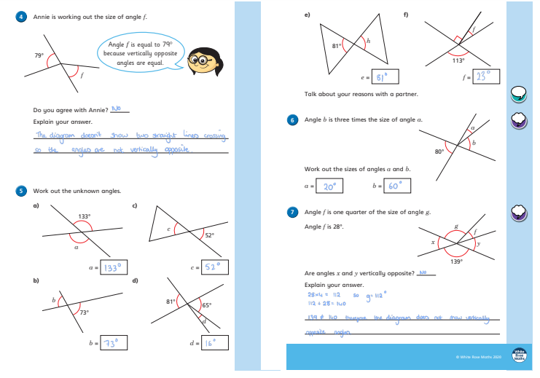

Slide 22
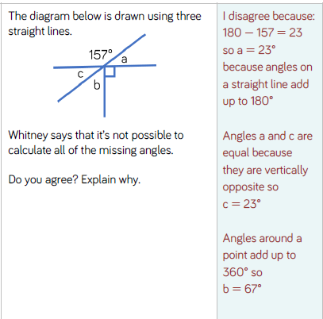
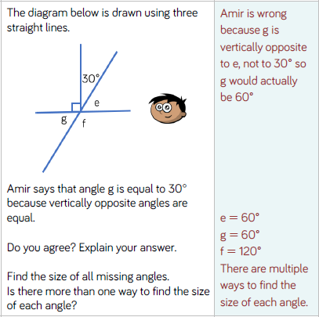

Slide 23
You will never guess what has happened to me! I have been plunged into a world I never quite believed in and if I am completely honest, I never saw this coming. I feel very overwhelmed.
As you know, I have moved into a huge, dusty, vintage house as filthy as a shack. In fact, it is more like a dozen shacks that have been stacked on top of one another!
Every now and then, I had been hearing sounds in the old walls that sounded like scratches or small footprints. It made me feel nervous because I was unsure what it was and part of me just wished that it would go away.
Yesterday, Mallory picked up an old broom in the kitchen and held it like it was a baseball bat. She quickly swung the bat at the pale, dull, worn wall and plaster came scattering to the floor beneath our feet like flour and a huge hole appeared (I knew Mom would blame me for it– she always does!).
Hesitantly, I stepped towards the ominous hole and I felt the hairs on my arms stand up. To my amazement, inside were the most bizarre objects! A doll’s head lolled in one corner. Dead cockroaches were strung up like garlands. Tiny soldiers with melted hands and feet were scattered all over like autumn leaves resting on the ground.
All of a sudden, the mysterious noise came back again! I had to quietly squeeze myself into the dumbwaiter (that’s where all the objects came from in the wall by the way) and it was really dirty inside and it smelled like old wood.
Nouns adjectives verbs adverbs Adverbials

Slide 24
After a while, I arrived in a secretive room that had a low ceiling and crowded bookshelves surrounded me. Slowly, I looked around the room and I realised there was no door! What a strange place it was!
Bravely, I began to explore the creepy room. I found an array of objects like old books, a pair of round glasses, a large watercolour painting of a little girl and a man pleasantly playing on the lawn and a note. Just as I was feeling confident, the peculiar noises returned along with my Mom! So, I had to go back downstairs, I felt so disappointed because I really wanted to stay longer to find more clues.
This morning, the craziest thing happened! My alarm clock didn’t wake me up…Mallory’s loud screaming did! Something had tied her long, silky, brown hair to the bed and of course I got the blame! It wasn’t me and it wasn’t Simon. I felt very confused!
Certainly curious, I knew what I needed to do. I used the clues from the strange note I found yesterday and bravely made my way up to the undisturbed attic. Eventually, when I got there the room I entered was bright and small with dusty windows on all sides. There wasn’t much in the room, only an old trunk, a Victrola, a small stool and rolls of faded fabric.
Nervously, I opened the large, dry, neglected trunk. Nothing inside looked like it was a secret or something to be hidden, there was simply moth-eaten clothes inside. I felt disappointed because I was eagerly hoping to find something fascinating!
Using the clues in the note I found, I knew there was something in the trunk but it took me a while to work out where. Eventually, a secret compartment popped open! Excited beyond reason, I quickly reached inside and found an old crumbling book that smelt like burnt paper.
Nouns adjectives verbs adverbs Adverbials

Slide 25
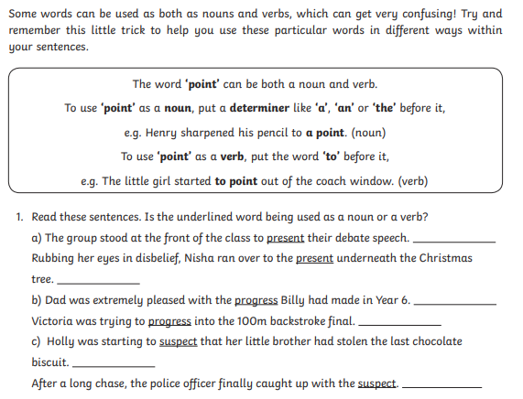
LO: To identify and apply various word classes
Wednesday 29th April

Slide 26
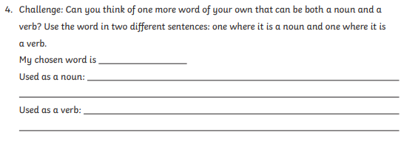

Slide 27
LO To calculate angles
in a triangle
Wednesday 29th April Maths
Please use the linked video : https://whiterosemaths.com/homelearning/year-6/ Summer Week 1 Lesson 3
We have moved to week 3 instead of 2 as many of you will not have protractors so week 2 becomes very difficult.
Please complete the worksheet before the deep/deeper.
Any questions please e-mail me at bstanley@bluecoat.uk.com

Slide 28
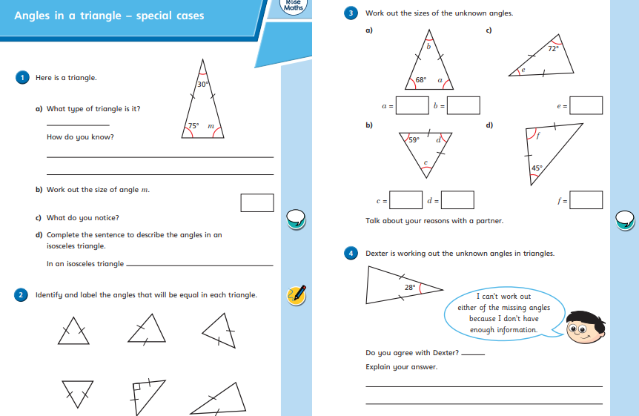

Slide 29
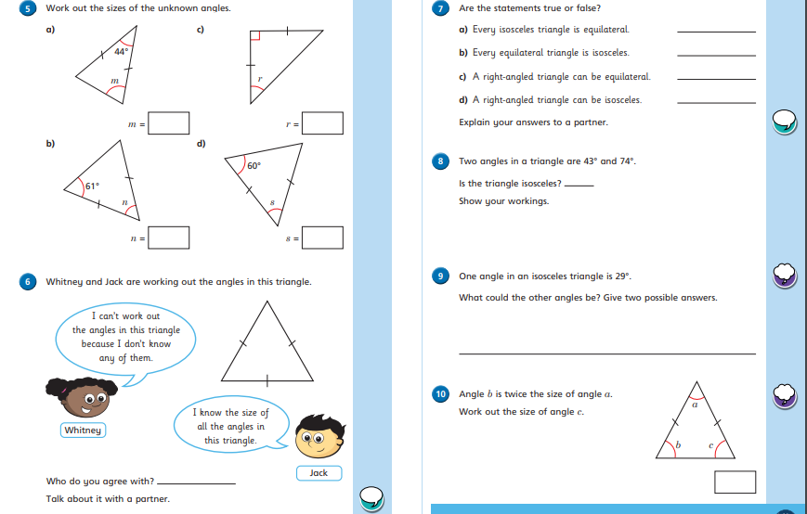

Slide 30
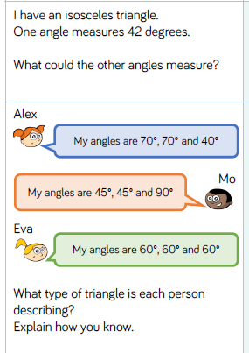
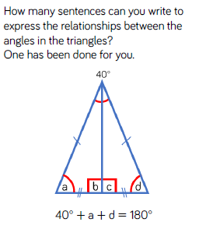

Slide 32
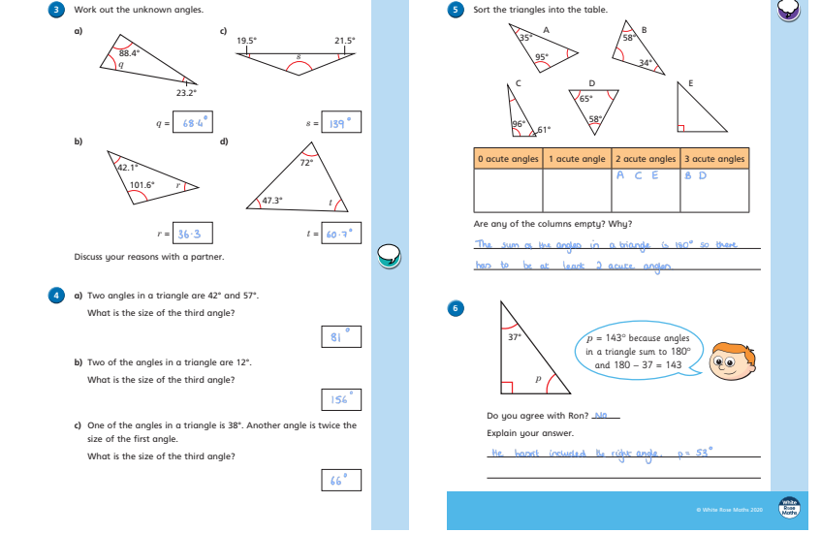

Slide 33
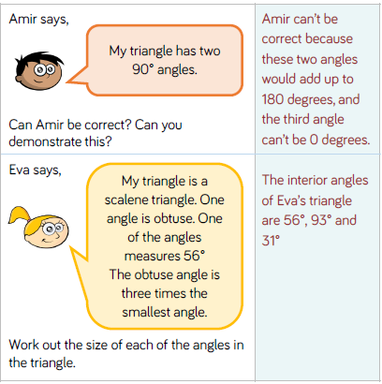
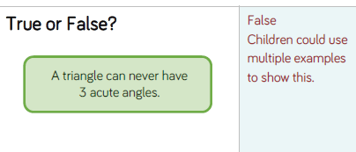
Such as 60 + 60 + 60
Or 70 + 50 + 60

Slide 34
Page 1
Like a bat.
A shack
She made a hole in the wall.
Doll’s head, dead cockroaches and tiny soldiers.
Your explanation must include a feeling and why.
As dirty as a shack; strung up like garlands; scattered like autumn leaves.
Page 2:
objects like old books, a pair of round glasses, a large watercolour painting of a
little girl and a man pleasantly playing on the lawn and a note
2) Mum arrived back home.
3) Disappointed/annoyed because she wanted to look around. (2marks)
4) It had no secret items inside.
5) Your explanation must include a feeling and why. (2 marks)

Slide 35
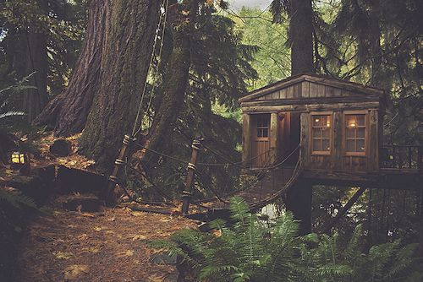
LO: To create descriptive sentences
Hi Year 6.
For Thursday 23rd April work I’d like you to use the image below to create descriptive
Sentences using a variety of impressive nouns, adverbs, verbs, adjectives and adverbials.
You will be writing a diary entry tomorrow either about what you’ve been doing this week or imagining you’ve found this room. Think about how you would feel, what you’d find and what you want to tell the reader.
Thursday 30th April

Slide 36
LO To find missing angles
Thursday 30th April Maths
Please use the linked video : https://whiterosemaths.com/homelearning/year-6/ Summer Week 1 Lesson 4
We have moved to week 3 instead of 2 as many of you will not have protractors so week 2 becomes very difficult.
Please complete the worksheet before the deep/deeper.
Any questions please e-mail me at bstanley@bluecoat.uk.com

Slide 37
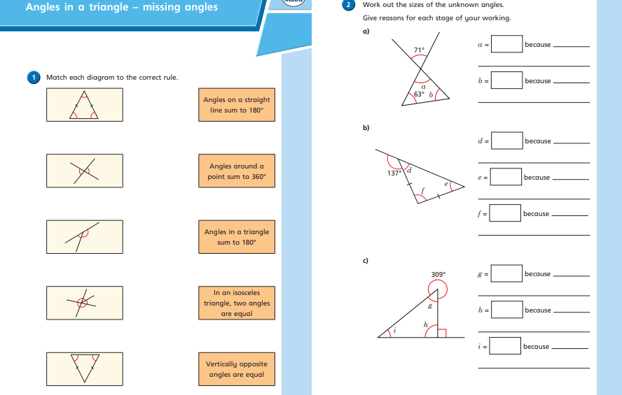

Slide 38
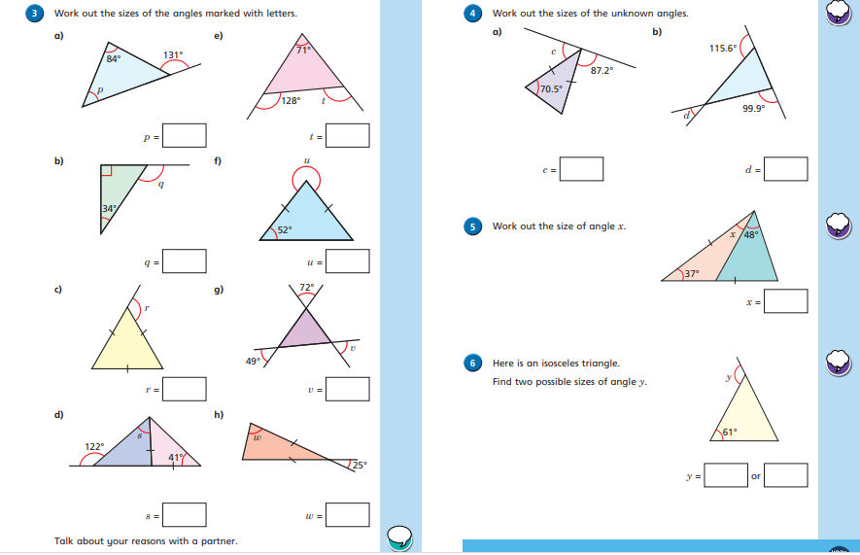

Slide 39
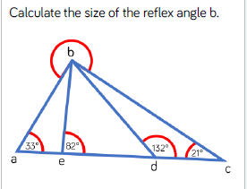
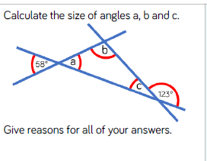

Slide 40
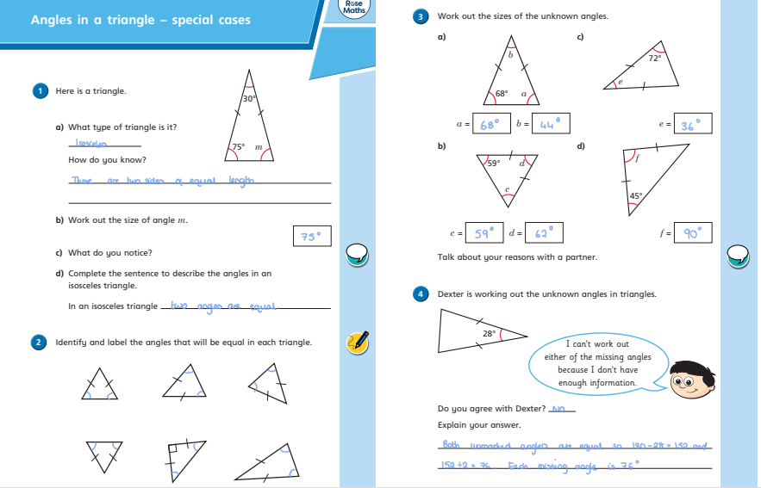

Slide 41
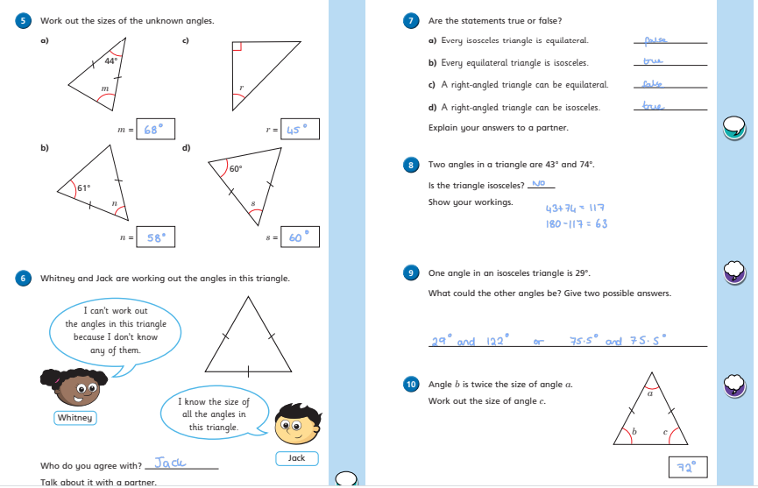

Slide 42
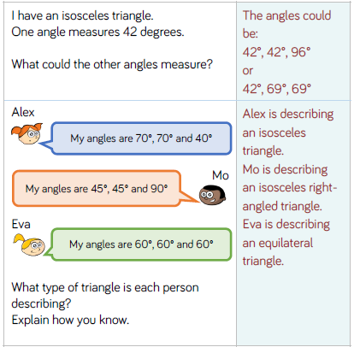
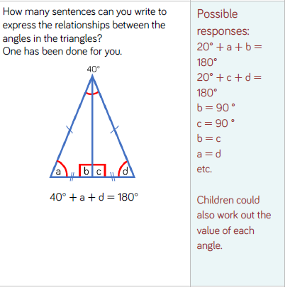

Slide 43
v
N
N
v
v
N

Slide 44
v
N
v

Slide 45
LO: To create a diary entry
Hi Year 6.
For Friday 24th April work I’d like you to use the image below to create a diary entry- imagine you are entering the building using a variety of impressive nouns, adverbs, verbs, adjectives and adverbials. If you want to create a diary about this week instead that is fine as well.
Think about how you would feel, what you’d find and what you want to tell the reader.
Friday 1st May

Slide 46
LO To find angles within
a quadrilateral
Thursday 30th April Maths
Please use the linked video : https://whiterosemaths.com/homelearning/year-6/ Summer Week 2 Lesson 1
Please complete the worksheet before the deep/deeper.
Any questions please e-mail me at bstanley@bluecoat.uk.com

Slide 47
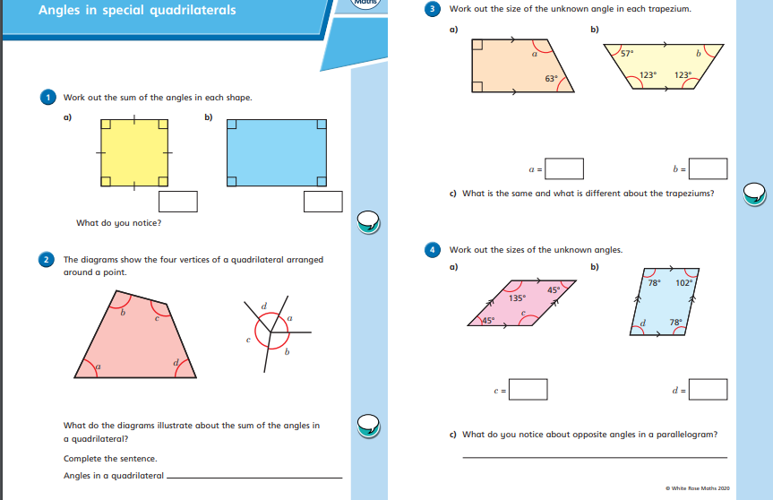

Slide 48
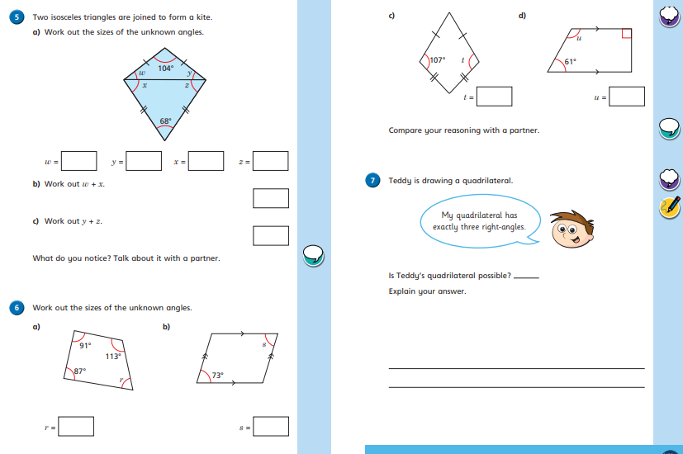

Slide 49
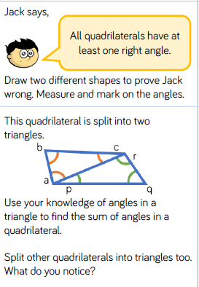

Slide 51
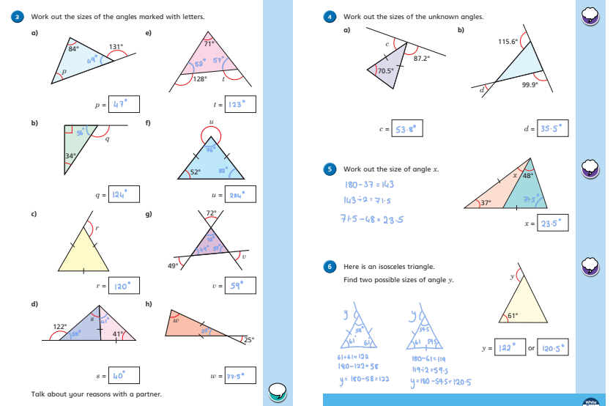

Slide 52
